Slide 1

HOSPI
An app for all your health needs.

Slide 2
PROBLEM STATEMENT
There isn't a single platform that allows doctors with certification to share patient’s medical information with other healthcare professionals, check supplies that are available and schedule appointments, and a metasearch engine to compare costs of various medical tests across hospitals and clinics.

Slide 3




CURRENT CHALLENGES
Inability to explain a previous diagnosis to a new doctor.
Price disparity for the same medical tests at various facilities.
A complex paper-based unnecessary approach.
Inadequate knowledge of medical supplies in a hospital.

Slide 4
MARKET
Target

Slide 5
WHY, THE INDIAN MARKET ?
The Indian Health-tech industry was valued at $1.9bn in 2020. By 2023, it is expected to reach $ 5B at a CGAR of 39%.
India has the world’s largest Health Insurance Scheme (Ayushman Bharat) supported by the government.
The digital healthcare market in India was valued at INR 116.61 Bn in 2018, and is estimated to reach INR 485.43 Bn by 2024, expanding at a compound annual growth rate (CAGR) of ~27.41% during the 2019-2024 period.

Slide 6
BUSINESS MODEL
Multiple business model-address multiple value propositions through one or more services :
B2C
SAAS
Advertising
DAAS

Slide 7
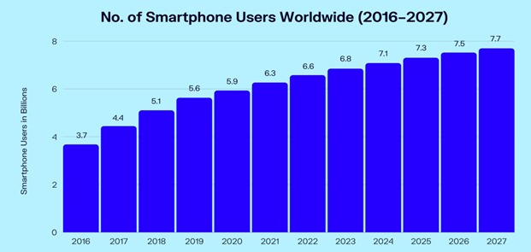
SOLUTION
A super app that combines the services, features, and functionalities of numerous healthcare providers and services into a single platform.
Why Super App ?
6.64 Billion (84%) global smartphone users.
1.2 Billion Smart Phone Subscriptions and around 750 million users in India (2021).
96% of the population will have access to smart phones by 2040.

Slide 8
THE CONCEPT
All in One Health Care Connected Ecosystem :)

Slide 9
ADOPTION
The NHA announced the launch of the Unified Health Interface (UHI) under the Ayushman Bharat Digital Mission (ABDM) in 2022.
The UHI will adopt an open protocol model where a set of shared technical standards will be shared with everyone in the system, with the aim of ensuring that patients and health service providers can interact with each other seamlessly even on different applications. Information right from admission to treatment and discharge in a paperless manner.

Slide 10
ADOPTION
The UHI will help implement the architecture for the NDHM having three main layers:
Digital Public Goods: The NDHM has an interface with several digital public goods such as Aadhaar, UPI, eSign, Digilocker, etc.
Health Data Exchange: This is the layer at which the key information will be stored and processed, including the Health ID, the Healthcare Professionals Registry and the Health Facility Registry, Health Information Exchange and Consent Manager, Health Data Standards.
User Applications: Hospi is the actual end user applications that provides a unique number to identify a person just like UPI Id and update their health records across multiple health service providers.User can also Access information right from admission to treatment and discharge in a paperless manner.

Slide 11
IMPLEMENTATION
Hospi uses an Enterprise Master Patient Index (EMPI) which is a database that is used to maintain consistent and accurate information about each patient registered by a healthcare organization. An EMPI can also aggregate patient data contained in separate systems within one facility. An EMPI uses algorithms to constantly look for duplicate records in a healthcare organisation's registration system and ensures that every patient is represented only once, and with constant demographic identification within all systems of hospital data.
Hospi uses a metasearch engine that is just like Trivago that compares prices of medical tests offered by different medical facilities. We compare and display different offers from many booking sites, and they pay us a fee if a user clicks on their specific deal.

Slide 12

SNIPPETS
A super app that solves all your health-related needs thus reducing friction.

Slide 13
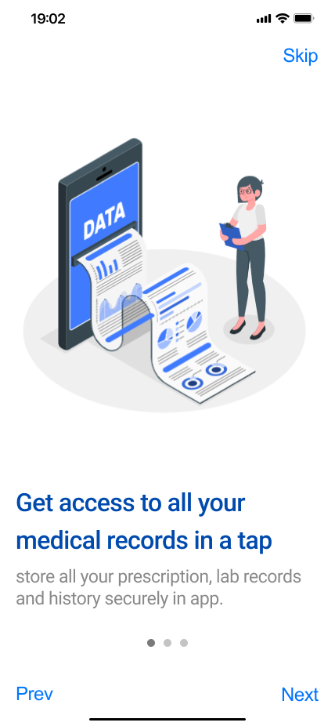
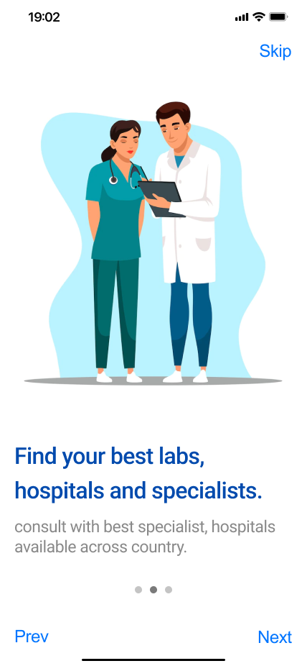
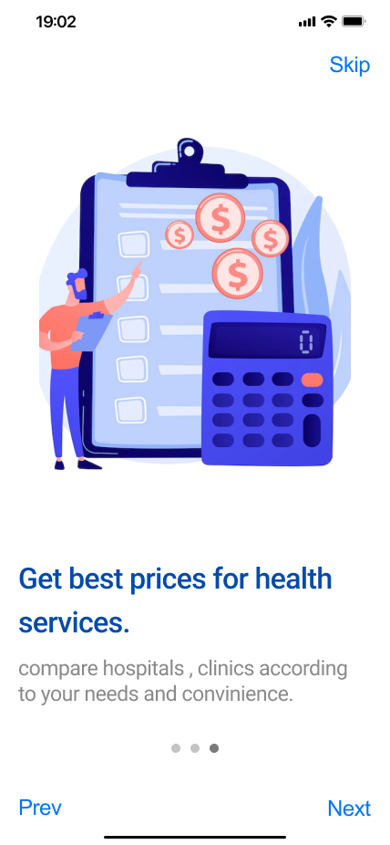

Slide 14
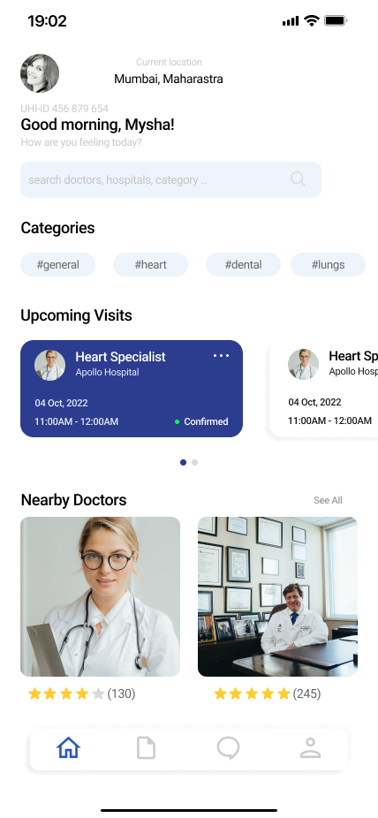
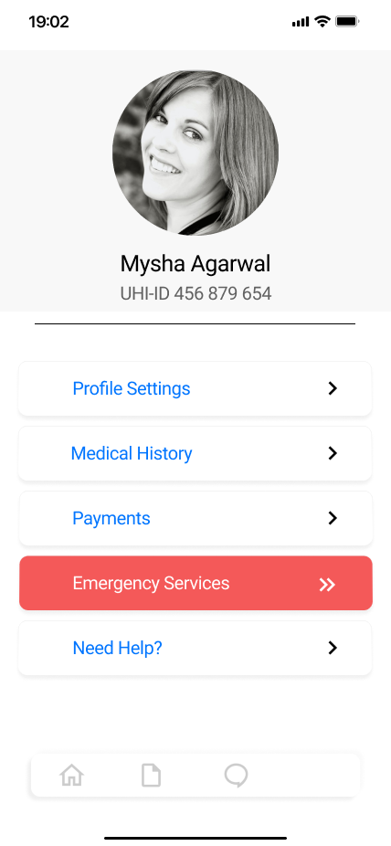
App Includes :
Access, link your Personal Health Records with Hospi to create longitudinal health history.
Implementation of UHI (unified health interface).
Price comparisons for medical testing at various institutions.
Provision for emergency services such as admittance, ambulance dispatch, general patient care, donation, insurance and so on.

Slide 15
FUTURE ROADMAP
Implementation of Organ Donation
Sourcing of Blood Banks
Making a Hospital Chain
1
3
5
2
4
6
Provision for Ordering Medicines
Services for Underprivileged people
Forming a Community

Slide 16

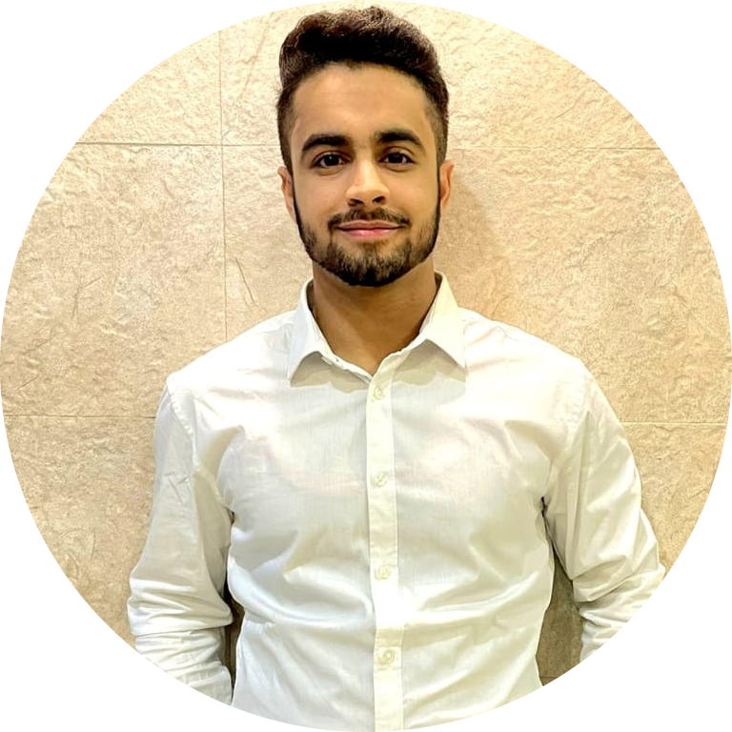


TEAM PRESENTATION
Divij Goyal 3rd year IT
Aryan Arora 3rd year CSE
Krish Tak 3rd year CSE
Arush Raj Agarwal 3rd year CSE

Slide 17
THANKS!
Any Questions?

